Slide 1
LOGIN SCREEN
LOADING SCREEN DASHBOARD SCREEN

Slide 2
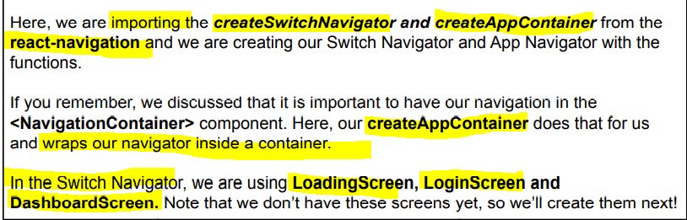
import { createSwitchNavigator, createAppContainer } from “react-navigation”

Slide 3
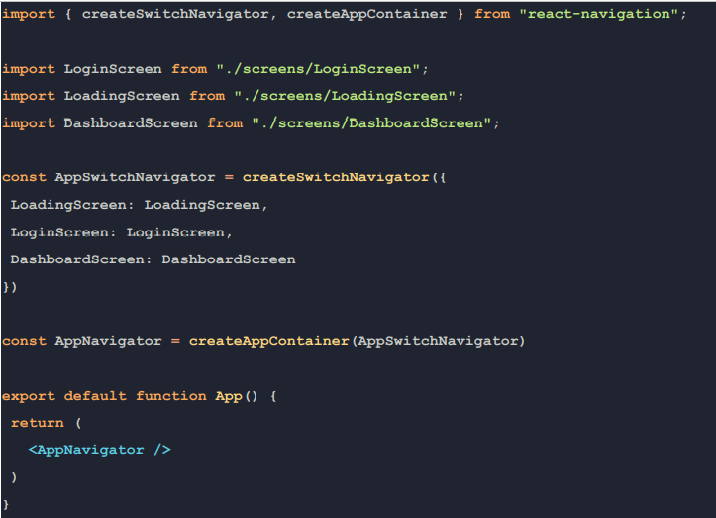
App.js

Slide 4
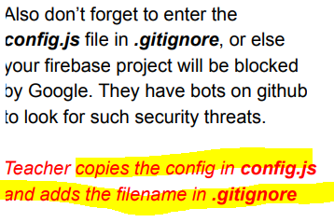
Creating Firebase App
Adding it to config.js

Slide 5
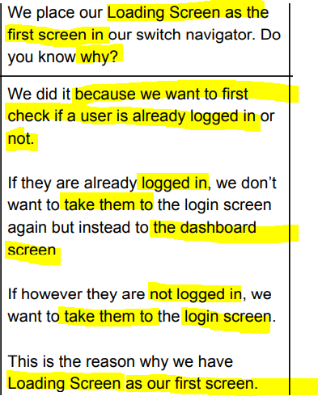
Loading screen decides whether a user goes to Login Screen or Dashboard Screen

Slide 6
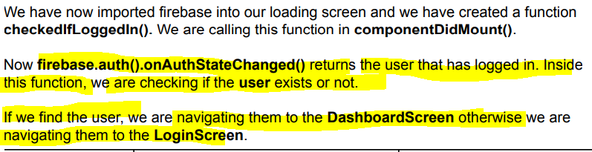
Loading Screen

Slide 7
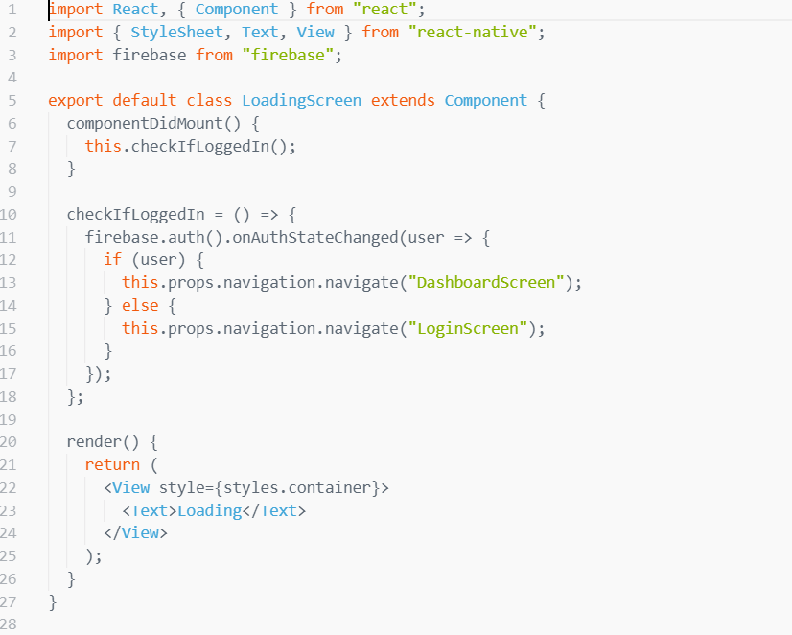
Loading Screen

Slide 8
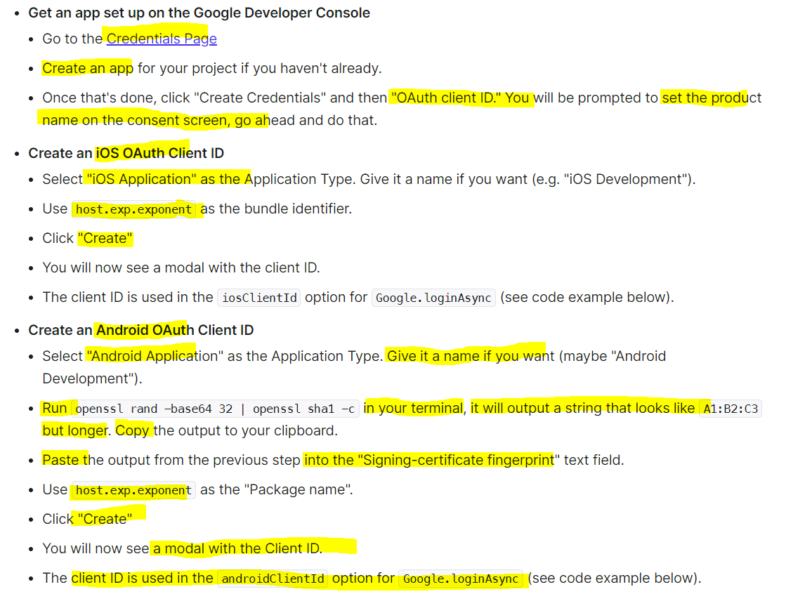
Steps to create Login Screen

Slide 9
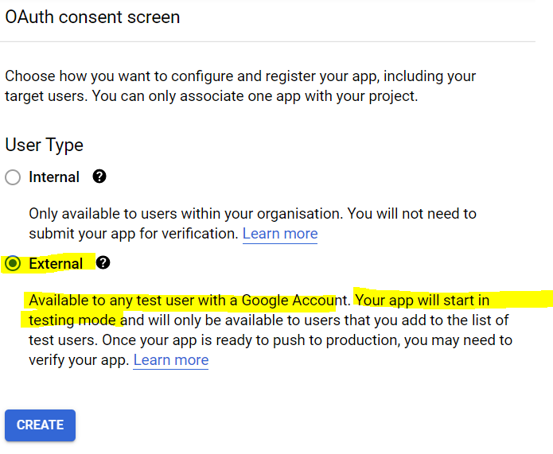
Steps to create Login Screen

Slide 10
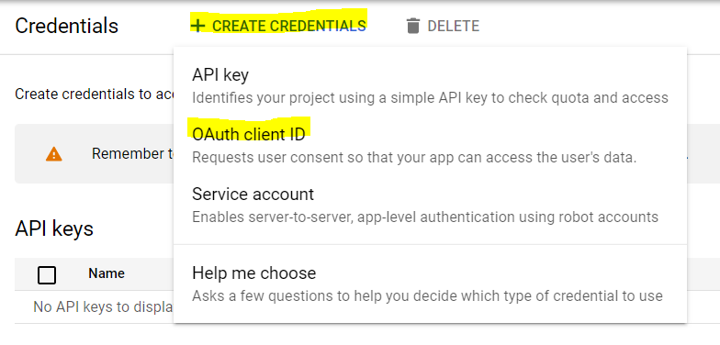
Steps to create Login Screen

Slide 11
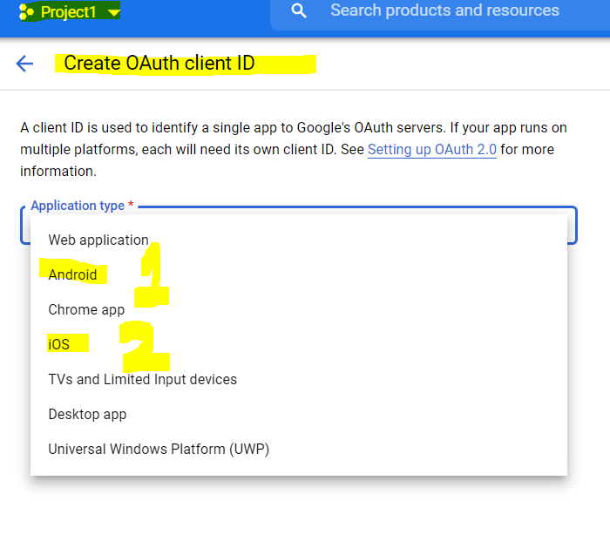
Steps to create Login Screen

Slide 12
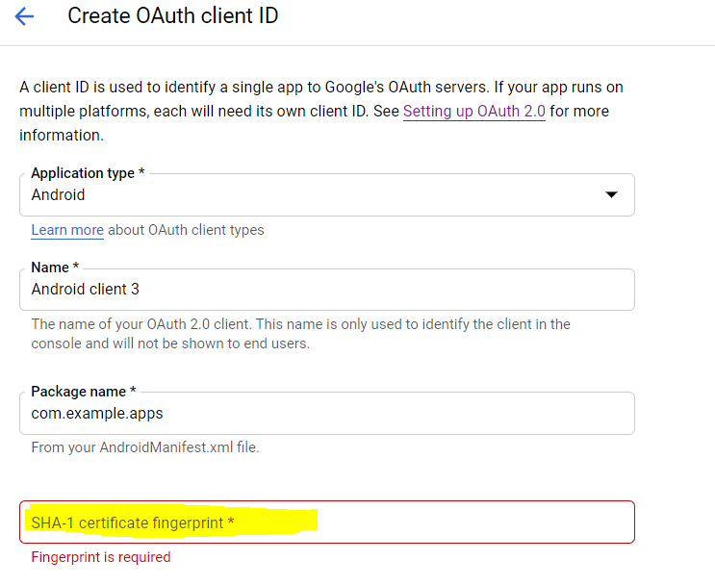
Steps to create Login Screen

Slide 13
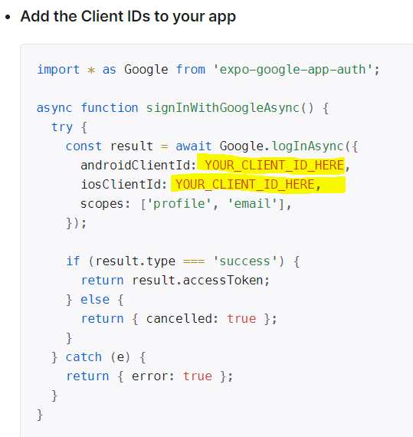
Steps to create Login Screen

Slide 14
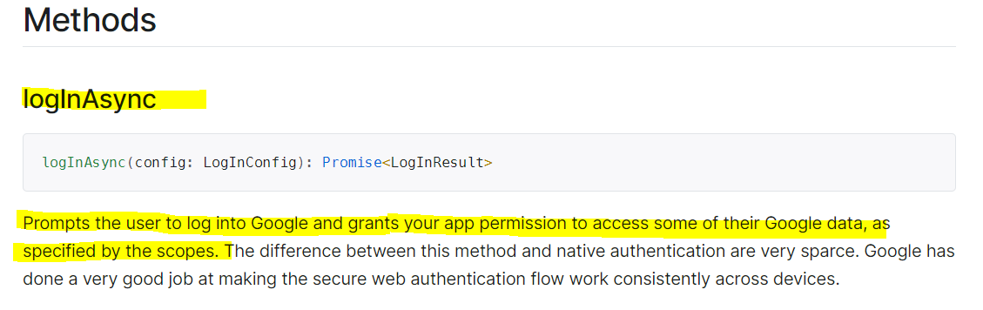
Steps to create Login Screen

Slide 15
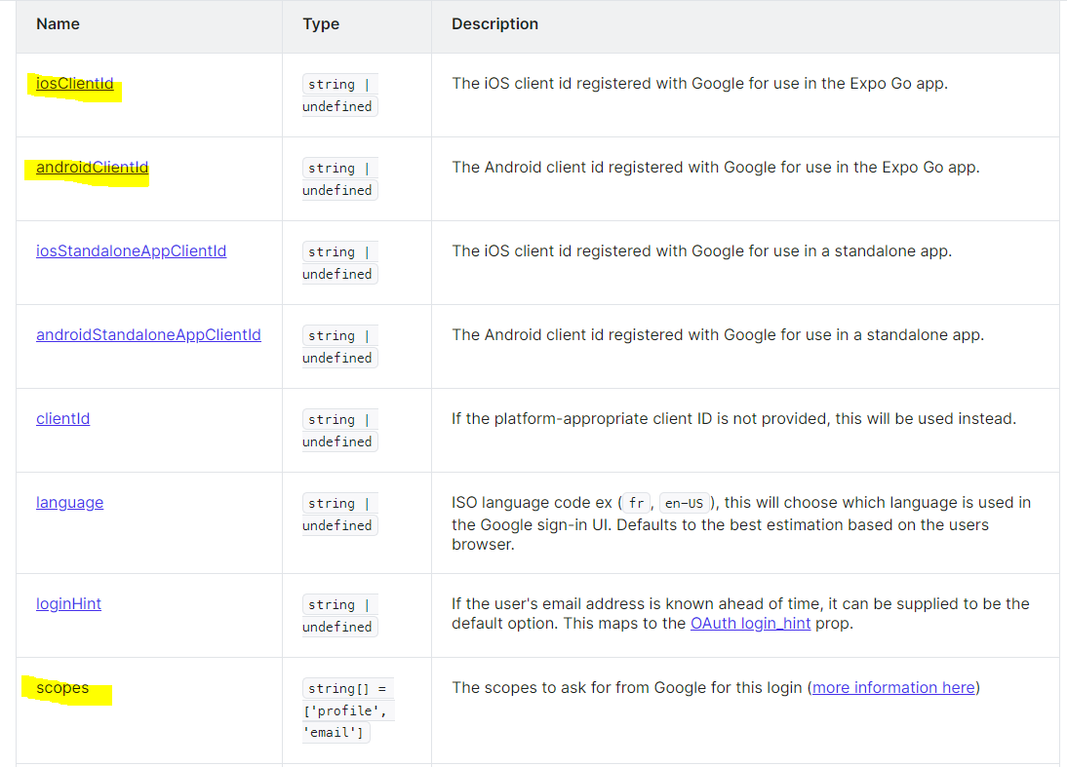
Steps to create Login Screen

Slide 16
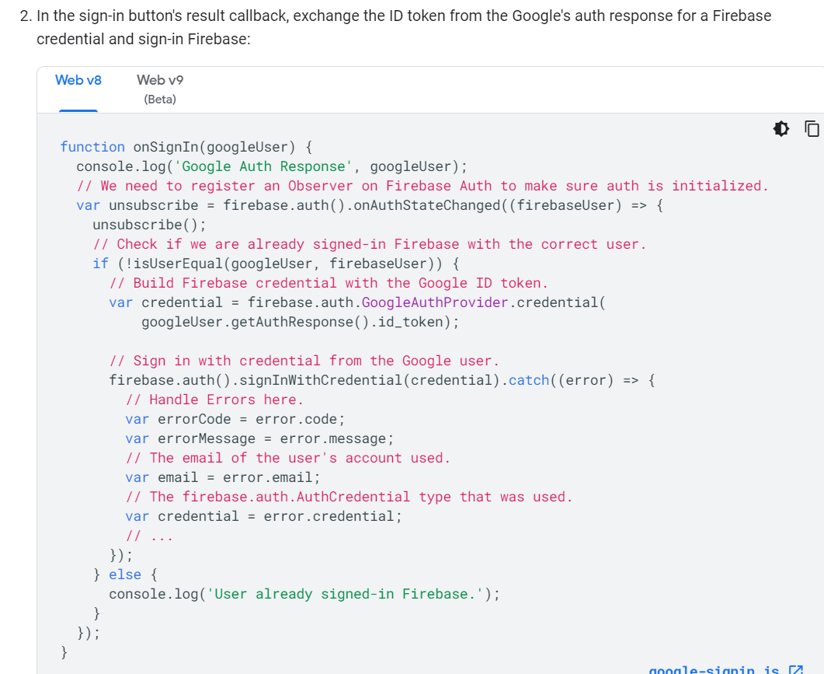
Steps to create Login Screen
Since we are not using access token anywhere through which we can access the email id it will throw an error.

Slide 17
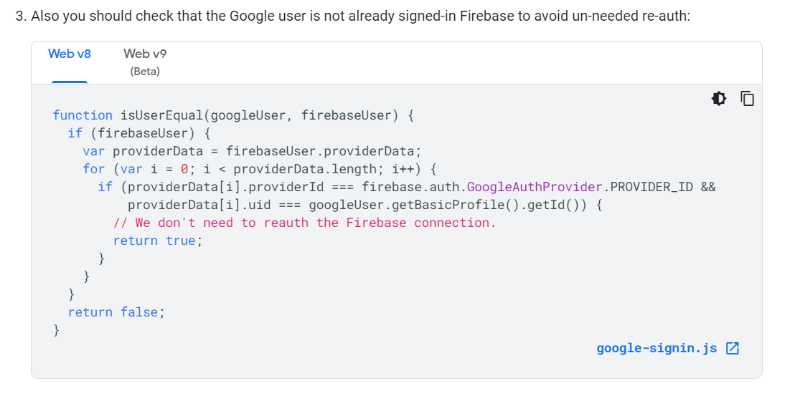
Steps to create Login Screen

